Slide 1
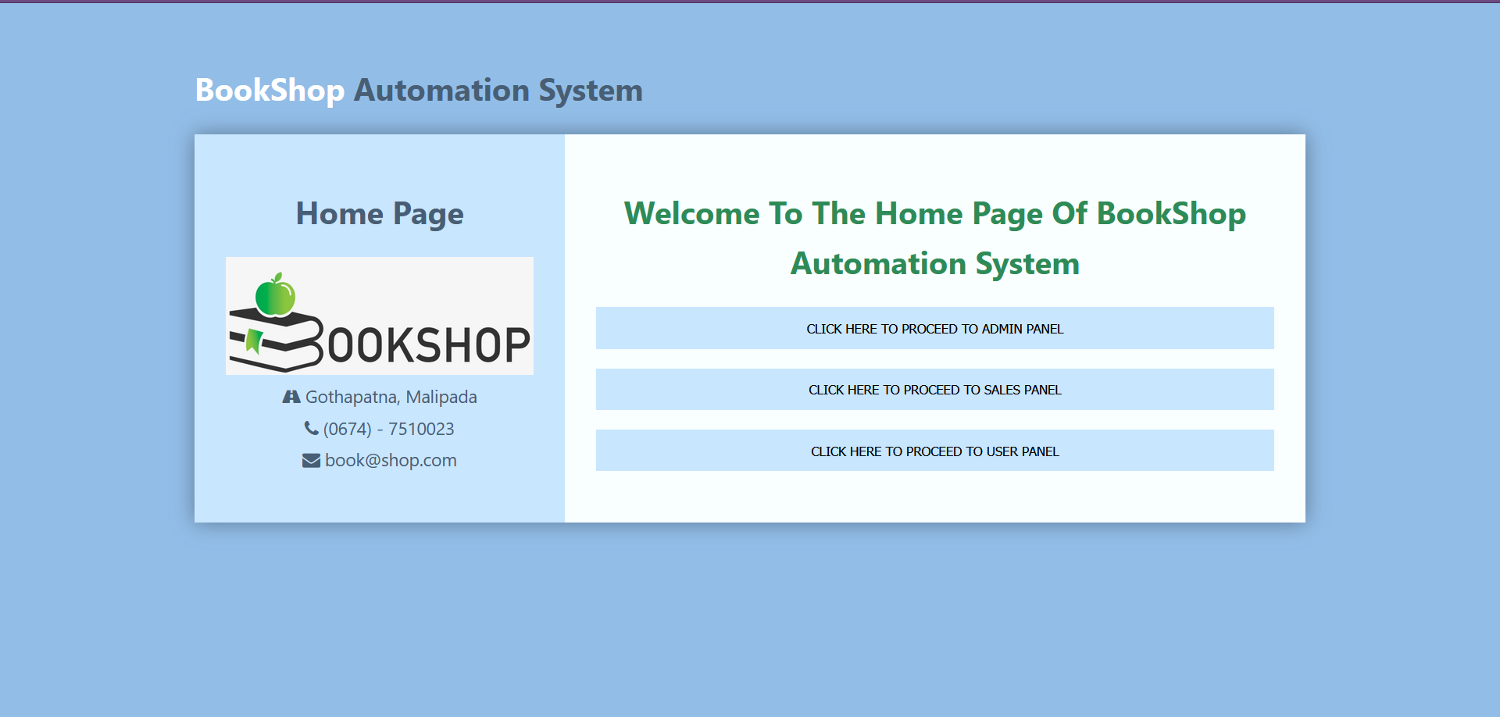
Guided By:
Jayashree Piri Ma’am
Submitted By:- Group 6
Aman Kumar Ray (B419014)
Nirmalya Ray (B419036)
Satwik Sahoo (B419051)
Samip Tripathy (B419050)

Slide 2
Table Of CONTENT
Introduction
Problem Definition
Life Cycle Model
Detail Data Flow Diagram
Structured Chart
Use Case Diagram for Entire System
Code Snippet
Test Output
Conclusion
Reference and Bibliography

Slide 3
INTRODUCTION
The Bookshop Automation System is to automate all operations in a bookshop. Generally it includes Order Processing, Stock Management and Accounts Management.
For example, if any customer wants to purchase any book from the shop then the customer can forage the database by its Title or Author’s Name. And then purchase it by paying the price on the bookshop cash counter and receiving its invoice. And if the required book is unavailable then he/she can put in a requisition.

Slide 4
PROBLEM DEFINITION
This project focuses on designing such efficient and reliable software which controls the transactions of a bookshop. In the real world, it tends to be associated with automated systems as they provide many benefits than doing the same thing manually.

Slide 5
LIFE CYCLE MODEL
We have followed the Waterfall Development Model for the Development of Bookshop Automation System Software.

Slide 6
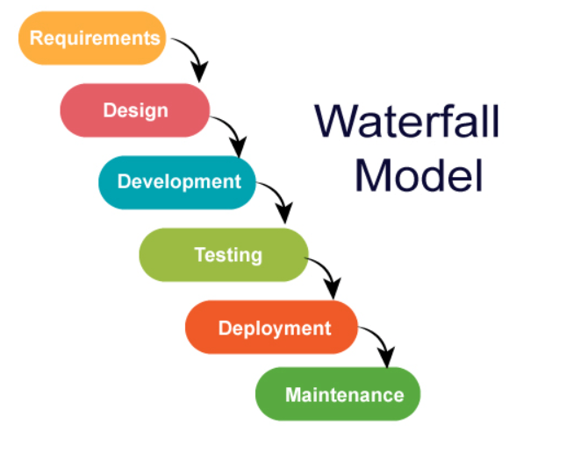
In "The Waterfall" approach, the whole process of software development is divided into separate phases. In this Waterfall model, typically, the outcome of one phase acts as the input for the next phase sequentially.

Slide 7
DATA FLOW DIAGRAM (DFD)
A data flow diagram (DFD) maps out the flow of information for any process or system. It uses defined symbols like rectangles, circles and arrows, plus short text labels, to show data inputs, outputs, storage points and the routes between each destination. They can be used to analyze an existing system or model a new one.

Slide 8
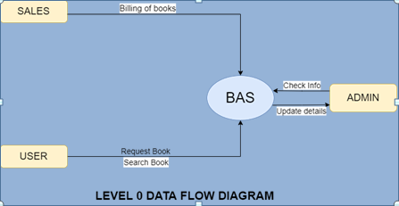
LEVEL 0 DFD
DFD Level 0 is also called a Context Diagram. It’s a basic overview of the whole system or process being analyzed or modeled. It’s designed to be an at-a-glance view, showing the system as a single high-level process, with its relationship to external entities.

Slide 9
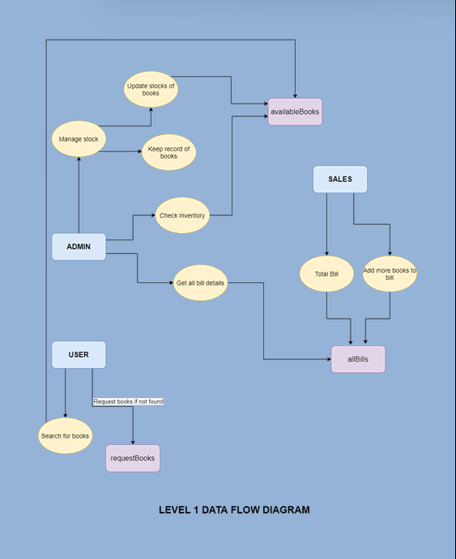
LEVEL 1 DFD
In 1-level DFD, the context diagram is decomposed into multiple bubbles/processes. In this level, we highlight the main functions of the system and break down the high-level process of 0-level DFD into sub processes.

Slide 10
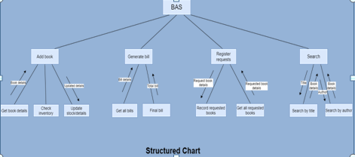
STRUCTURED CHART
Structure Chart represents hierarchical structure of modules. It breaks down the entire system into lowest functional modules, describing functions and sub-functions of each module of a system to a greater detail. The lines represent the connection and or ownership between activities and sub activities as they are used in organization charts.

Slide 11
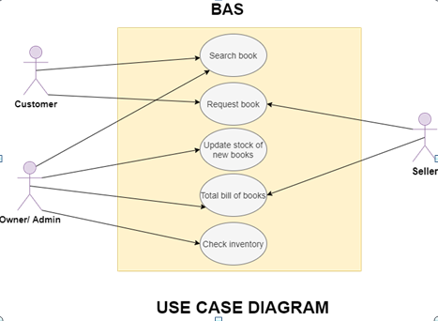
USE CASE DIAGRAM
A use case diagram is the primary form of system/software requirements for a new software program underdeveloped. Use cases specify the expected behavior, and not the exact method of making it happen

Slide 12
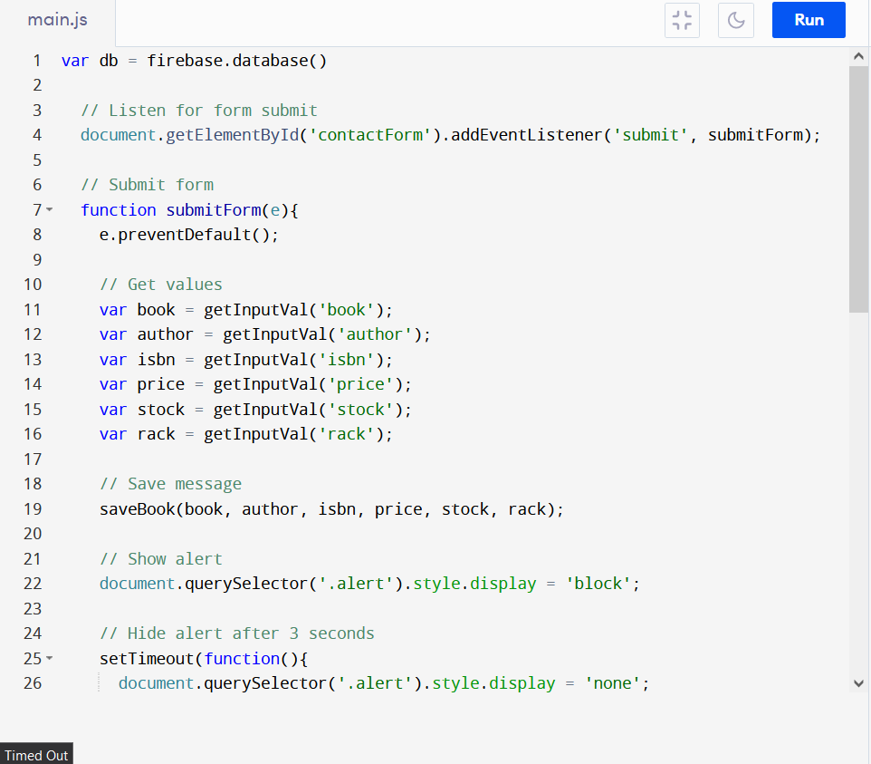
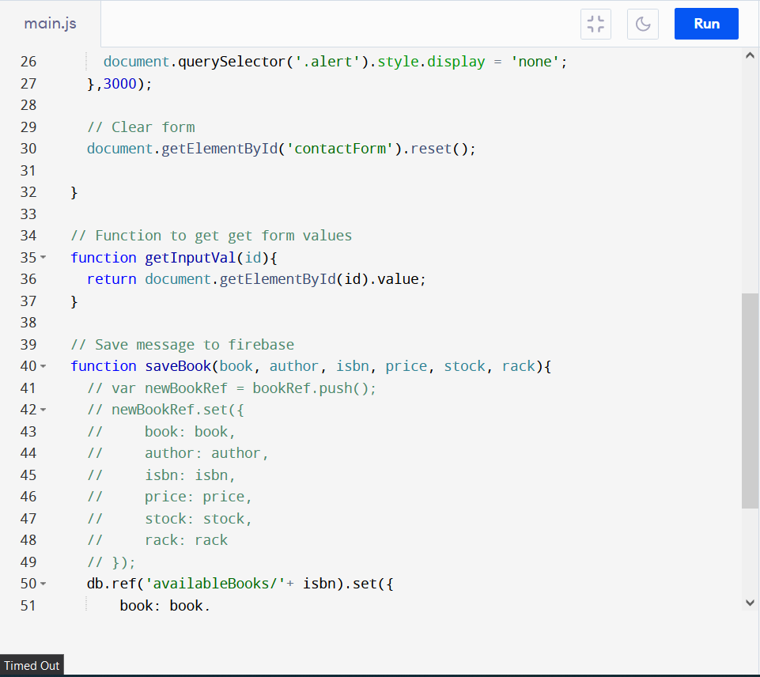
CODE SNIPPET

Slide 13
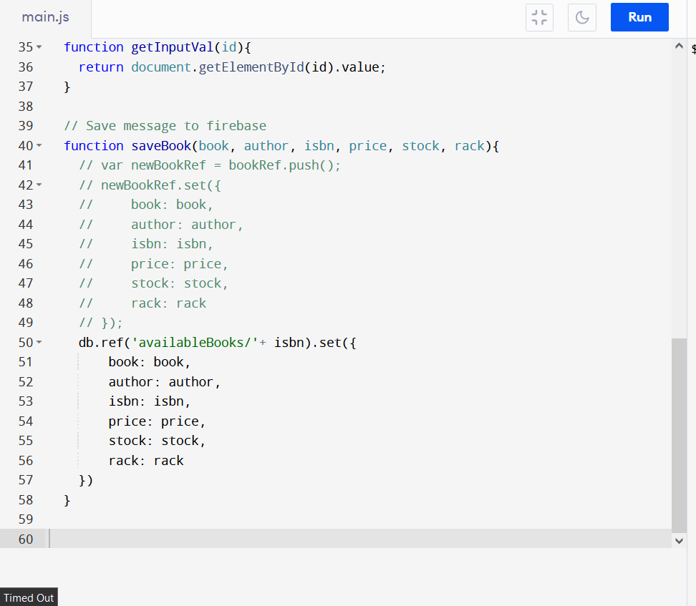

Slide 14
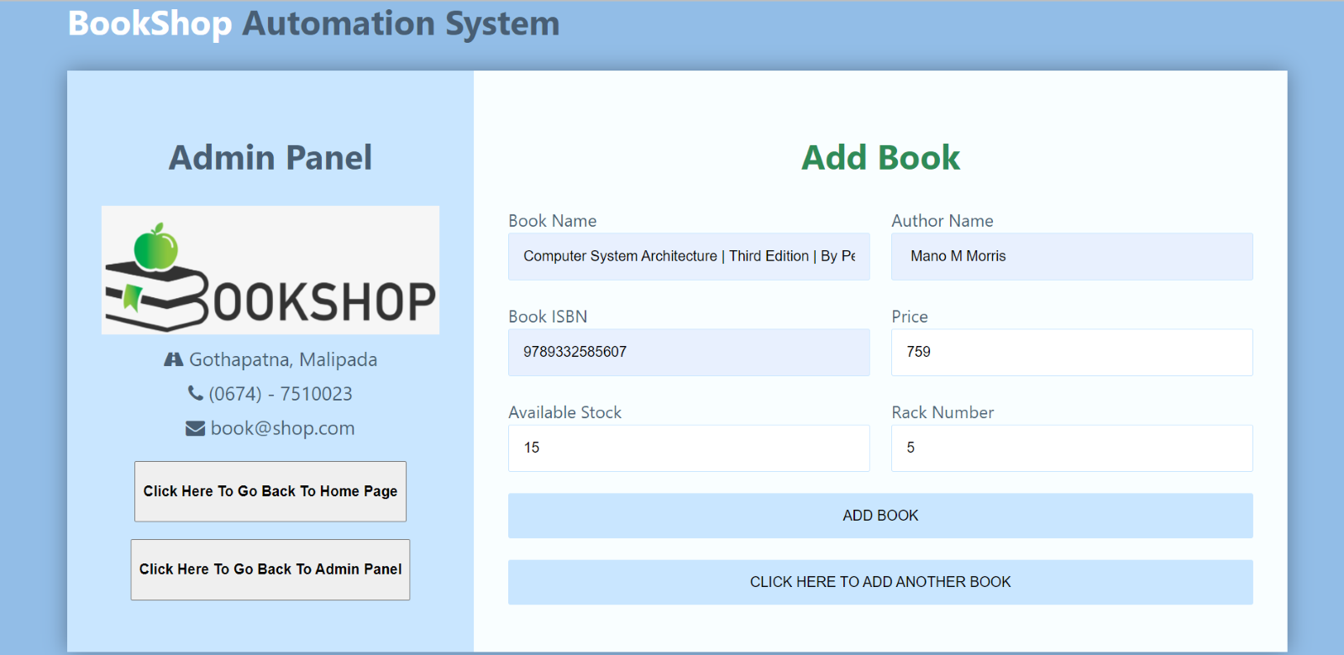
OUPUT
Add Book

Slide 15
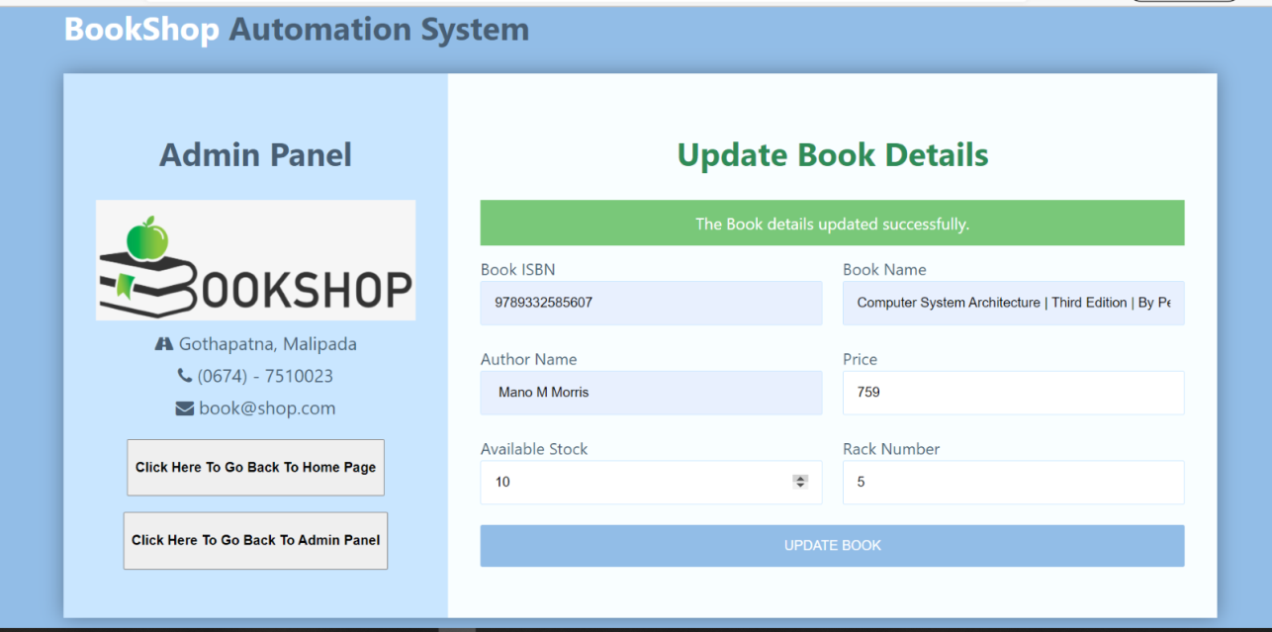
OUPUT
Update stock/details of book

Slide 16
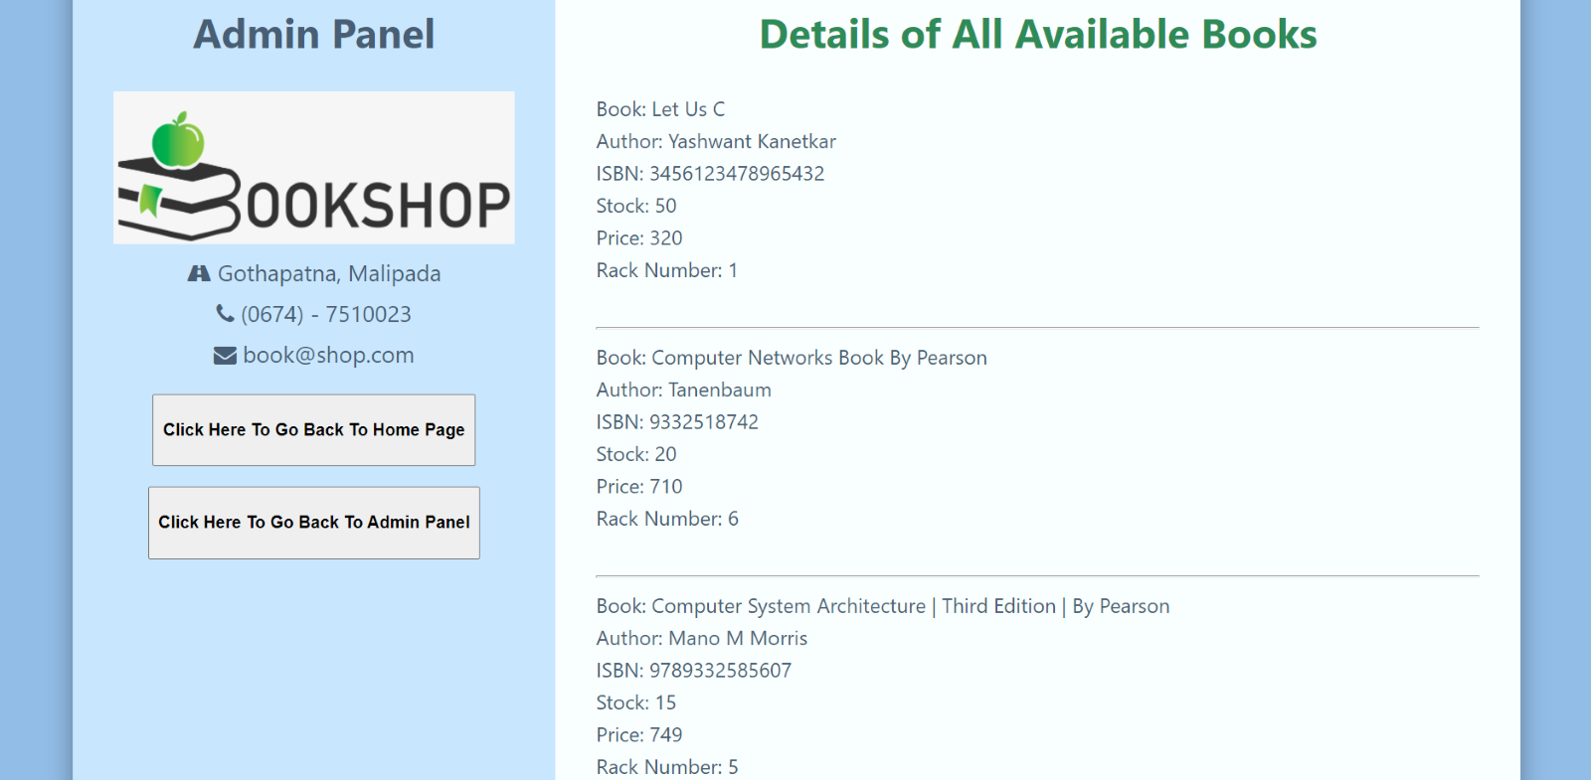
OUPUT
Details of All book Available

Slide 17
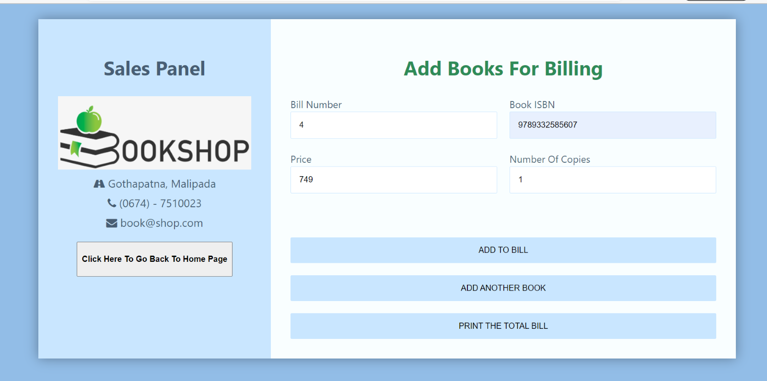
OUPUT
Add Book for Billing

Slide 18
CONCLUSION
This Bookshop Automation System is an attempt to overcome the present inefficient and time consuming process of locating, reserving and purchasing quality reading materials available in the store.
All the newly coined processes will address time consuming, ineffective and inefficient areas of the existing system which has being wasting a lot of firms resources such as, labor, electricity, equipment, products and services, while discouraging customers to make purchases and repelling clients from the book store.

Slide 19
Even though these advantages prevail, due to lack of IT literacy and fluency of clients and lack of distribution of internet facility will have a negative impact and it will take some time to cover up the capital investment made on implementing the new system. Since the technical facilities are expanding in great heaps, the proposed system will facilitate enhancing productivity immensely

Slide 20
REFERENCE AND BIBLIOGRAPHY
https://www.javatpoint.com/software-engineering-tutorial
https://www.tutorialspoint.com/software_engineering/index.htm
https://en.wikipedia.org/wiki/Software_engineering
http://software.isixsigma.com/library/content/c040915b.asp

